Slide 1




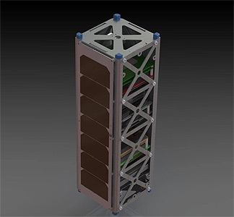
EagleSat-2
Project Management Practices for
Large Undergraduate Space Projects
Calvin Henggeler
B.S. Computer Engineering, May. 2024
EagleSat-2, Project Manager
Certified Associate in Project Management (CAPM)
Logan Ruddick
B.S. Aerospace Engineering, Astronautics, Dec. 2024
EagleSat-2, Bus Systems and Integration Team Lead
Advisor: Dr. Ahmed Sulyman
Professor of Electrical Engineering
College of Engineering, Department of Computer, Electrical, and Software Engineering
EagleSat-2 3D-Model Rendering

Slide 2
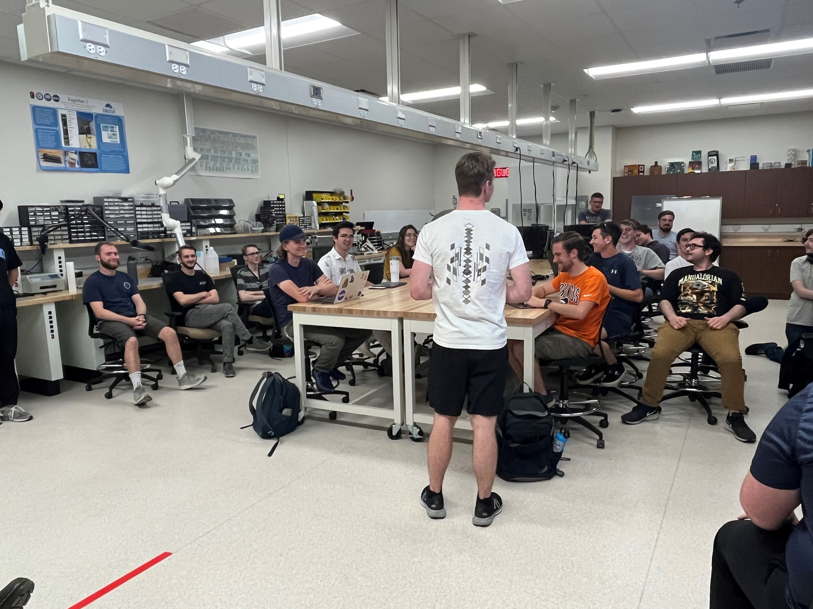
Challenges of Undergraduate Space Projects
Student Availability
  Classes
  Summer/Winter Break
  Other Clubs and Commitments
Complexity
  Technical Experience
  Cost
  Regulations
  Quality Control
EagleSat-2 Fall 2023 Kickoff Meeting

Slide 3
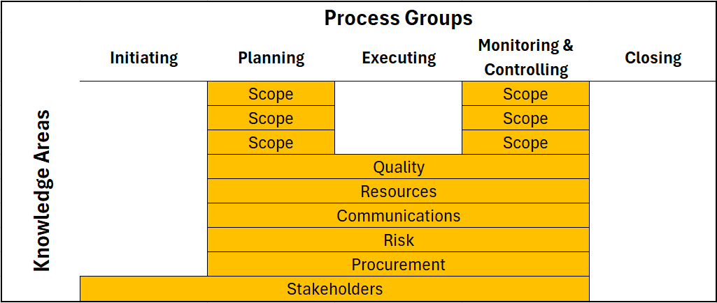
Project Management Responsibilities
Scope Management
Schedule Oversight
Resource Allocation
Risk Management
Stakeholder Mediation
Communication Moderation
Quality Control
Relationship between Process Groups and Knowledge Areas
Project Management Body of Knowledge 7th Ed,
Project Management Institute

Slide 4
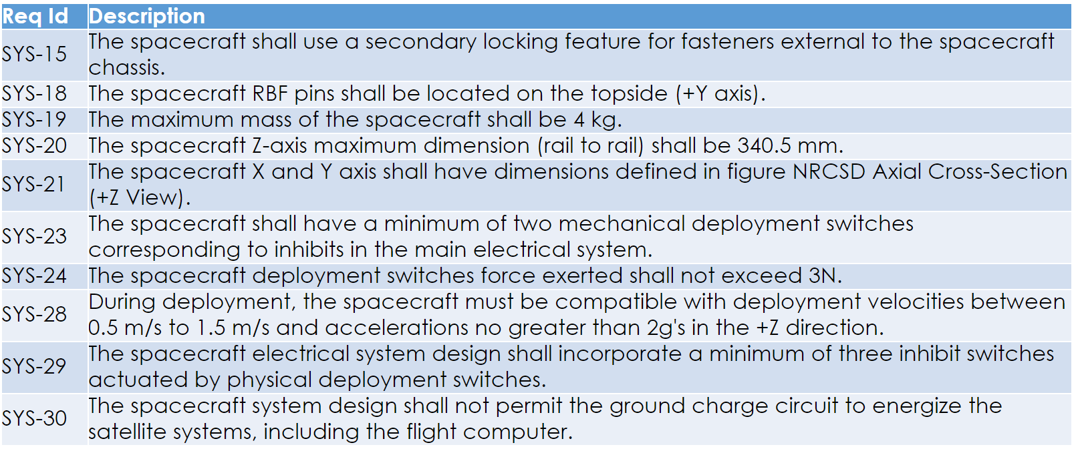
Scope Management
Scope Management – Defining the work that is required gets complete, and only that work
Issues
Scope Creep
Rework
Techniques
Requirement traceability matrix
Work Breakdown Structure
Change Control Process
System Requirements from EagleSat-2 Critical Design Review

Slide 5
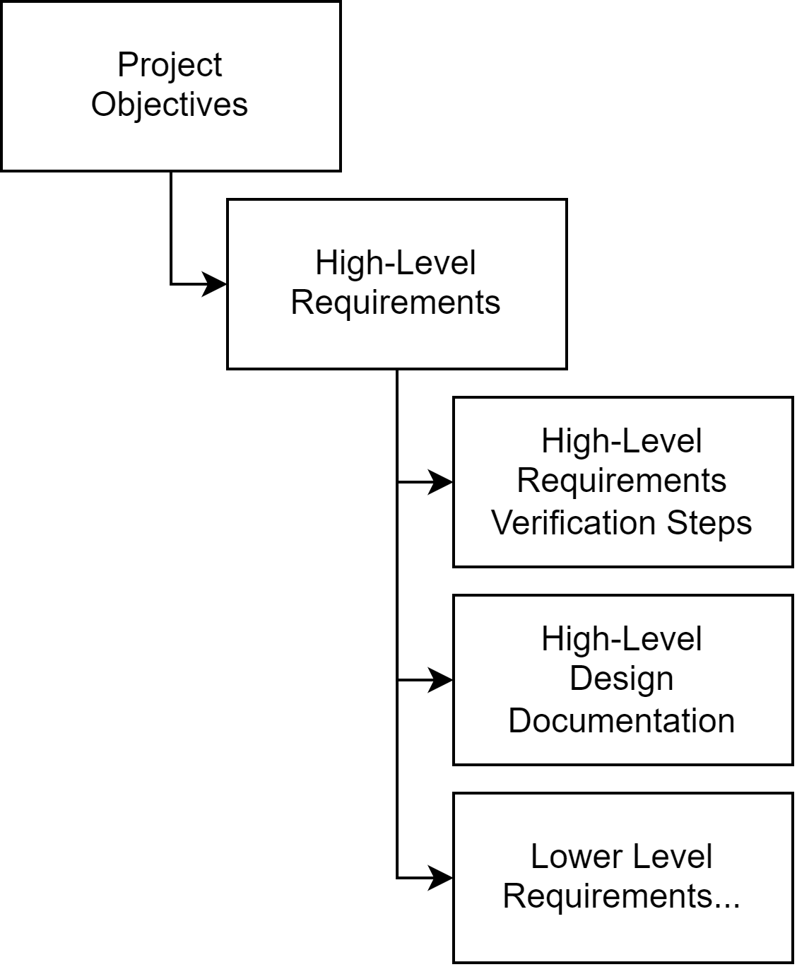
High-Level Requirement Management
High-Level Requirements – Requirements immediately derived from project objectives, from which lower-level (technical) requirements sets are derived.
Create common ground with Stakeholders (to come)
Interpret Goals into verifiable characterizations of product
Tools
  Rational DOORS
  Doorstop (Open Source)
  Jira/Jama
Example Object Oriented Document
Requirements Inheritance

Slide 6
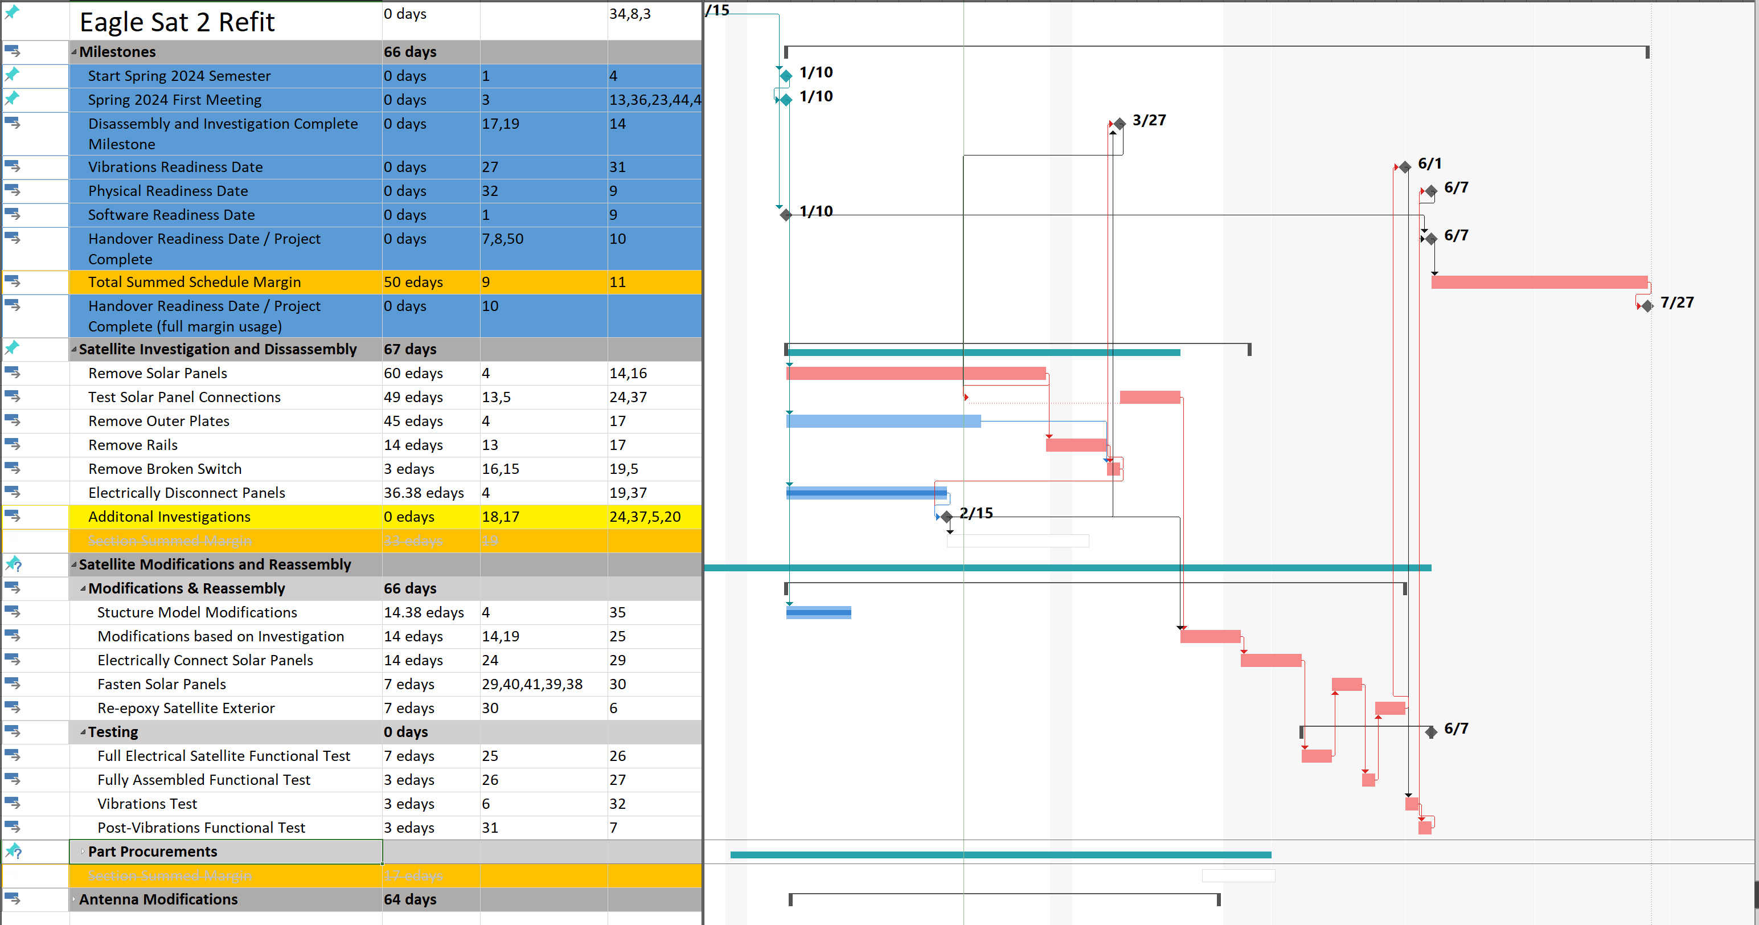
Schedule Management
Task Breakdown
Critical Path
Deadline Management
Schedule Building
  Duration estimation
  Margin
EagleSat-2 Project Schedule Excerpt

Slide 7
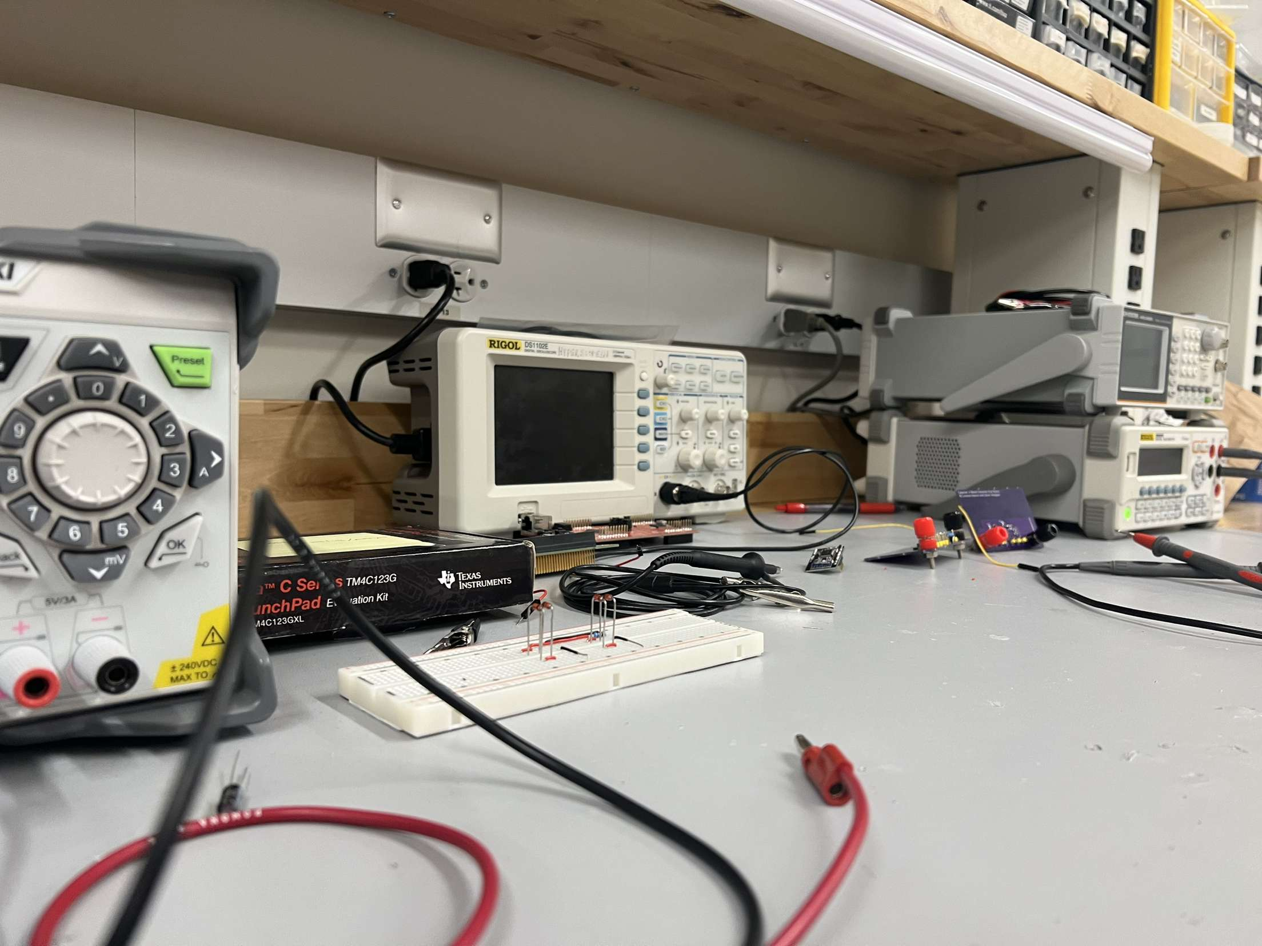
Cost and Procurement Management
Acquiring Funding
Procuring Tools and Equipment
Acquiring hardware
Vendors
Expenditure limitations and lead times
EagleSat’s electronics test equipment and prototype boards

Slide 8
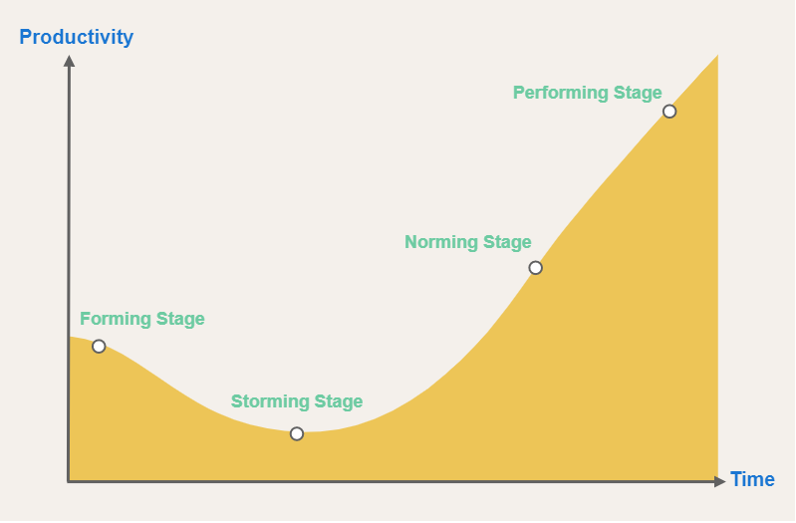
Resource Management
Project Resource – Team members or any physical item needed to complete the project.
Recruiting (Forming)
  Under vs upper classmen
Keeping Member Interest (Storming)
Team Member Allocation and Assignments (Norming)
  Demand
  Interest
  Skill set
Tuckman Model
B. Tuckman, Developmental Sequence in small groups (1965)
Diagram from nulab.com
Notes:
Biggest

Slide 9
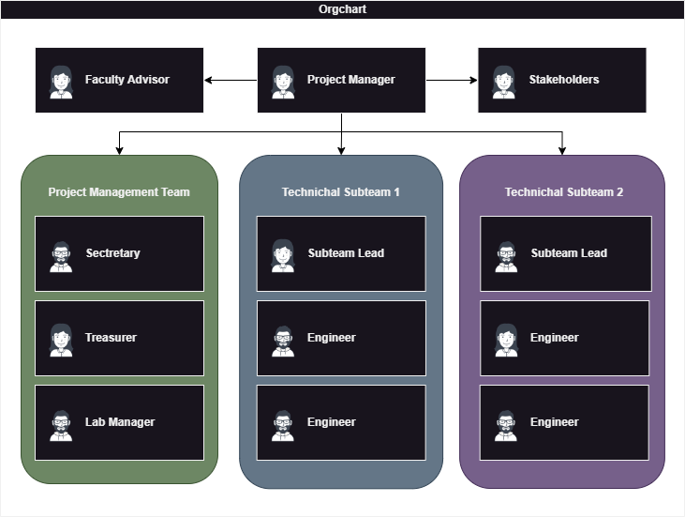
Resource Management – Team Dynamics
Sub-team breakups
Contributions
  High-Performing Individuals
  Sporadic Contributors
  “Pennies add up”
Succeeding leadership must come from within
High level of trust in sub-team leads
Generalized EagleSat-2 Organization Chart

Slide 10
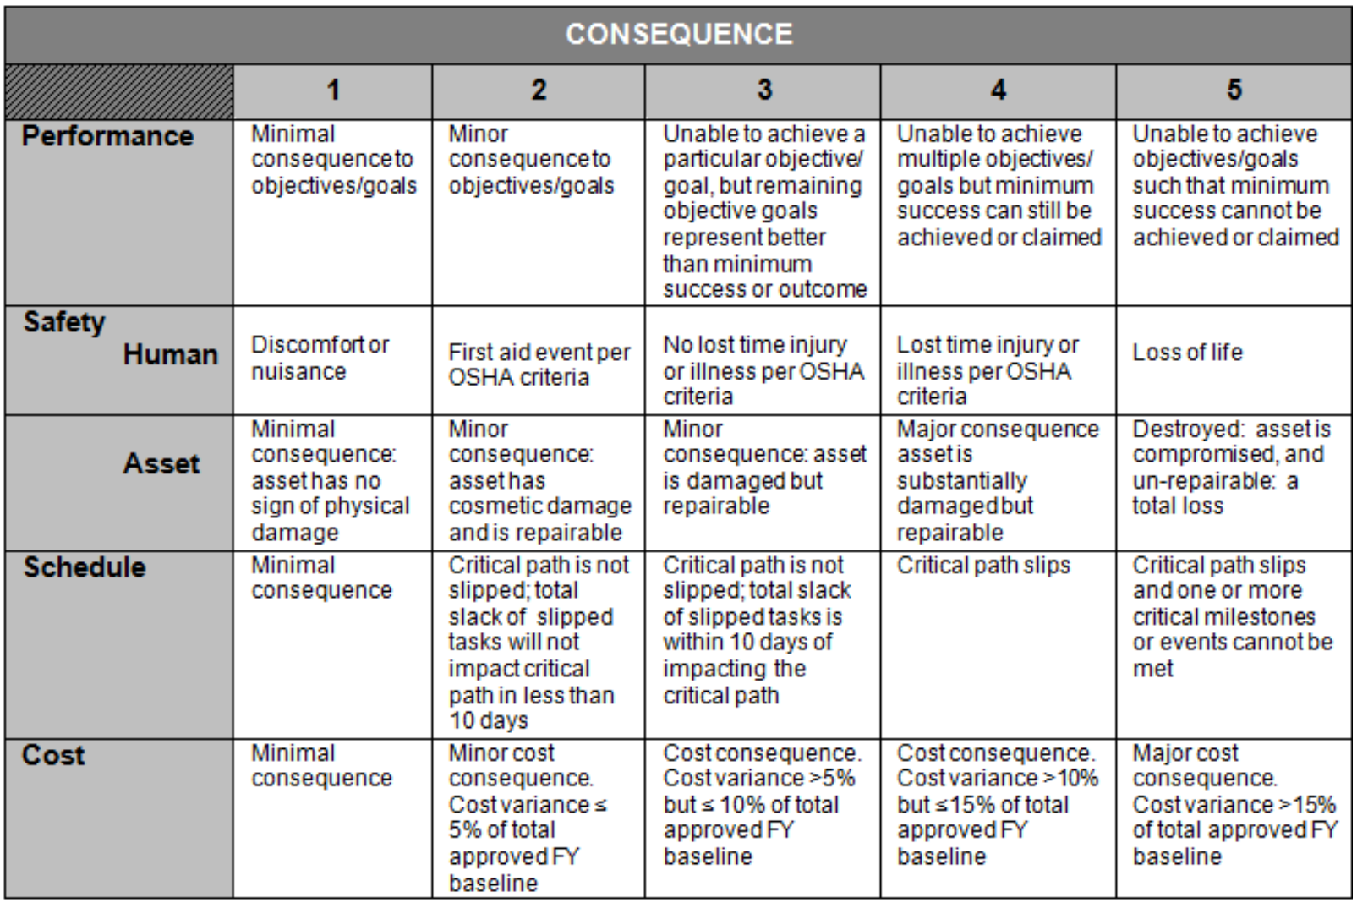
Risk Management
Risk Register
Risk tracking personnel
Cost, time, scope risks
Risk Likelihood and Consequence Criteria: From NASA’s S3001: Guidelines for Risk Management

Slide 11
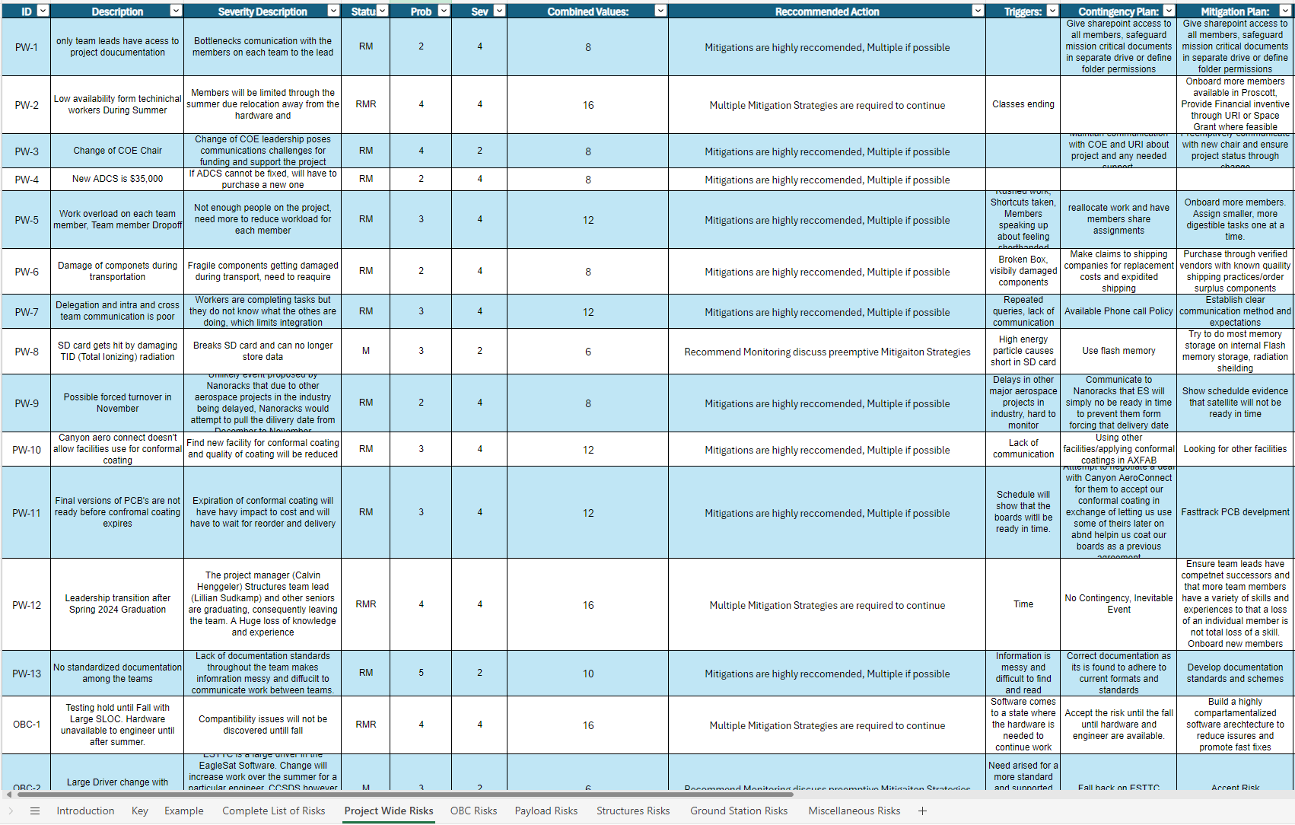
Risk management - Risk Register
Contingency and Mitigation plans
Triggers
Description
EagleSat-2 Risk Register Excerpt

Slide 12
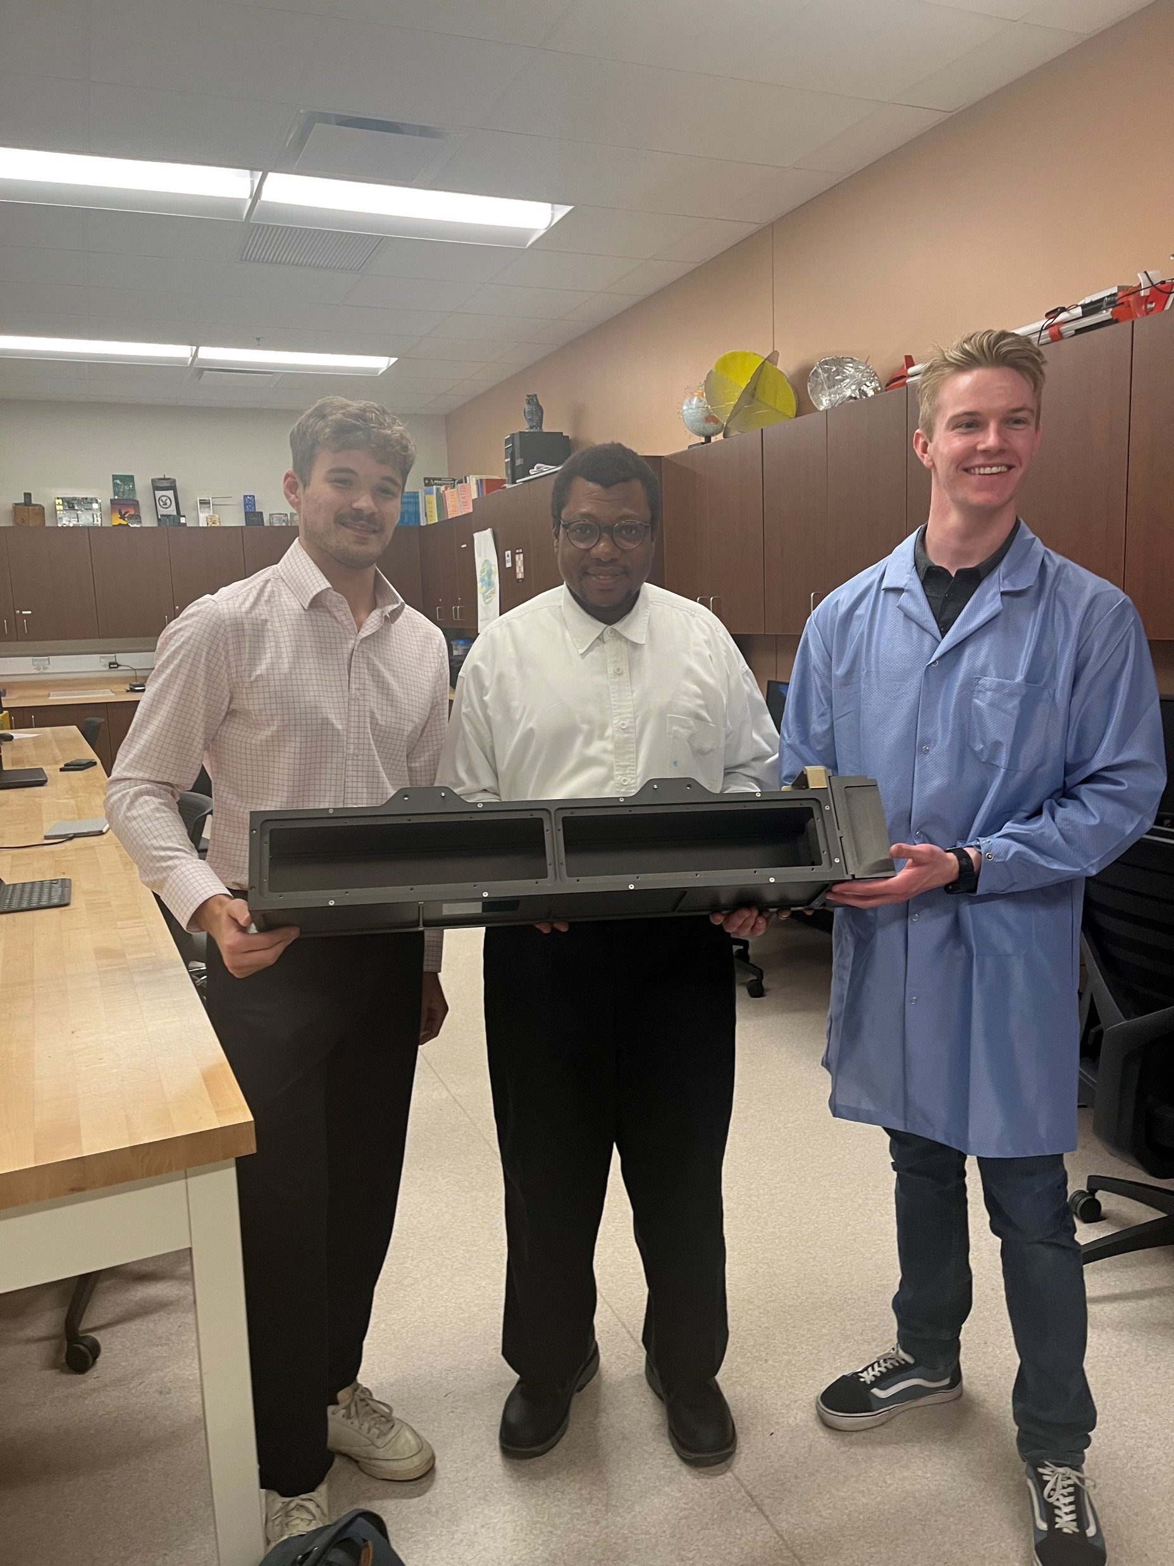
Stakeholder Management
Stakeholder – Person, group, or organization that could impact or be impacted by the project.
Transparency
  Two-way communications
Expressing Needs
  Monetary or Human resources
Mitigating Expectations
  Timeline, Budget, Quality
EagleSat-2 Project Manager with Stakeholders
Notes:
Transparency: Two way honest and consistent updates about needs and expectations
Comment on the consequences of improper stakeholder management
Loss of trust from stakeholders and sponsors
Possibility of shutting down a program
Wasted time and money
Stating you are ready for a test or license update to b processed but you are not, and it would then need to be done again
Examples of proper stakeholder management and communication
Example 1: Communicating constant updates about steady progress to then schedule a vibrations test in a timely manner
Example 1:
Lack of programmers →Reach out to URI/CoE → Advertise for more members
Example 2:
Updating nanoracks about RF cable material scenario →they recommend material

Slide 13






Communications Management
“90 % of a project manager’s job is Communication”
–Reg Parker PMP
Different communication methods for different purposes
Regular Communication
Teamwide Communication
Meetings

Slide 14
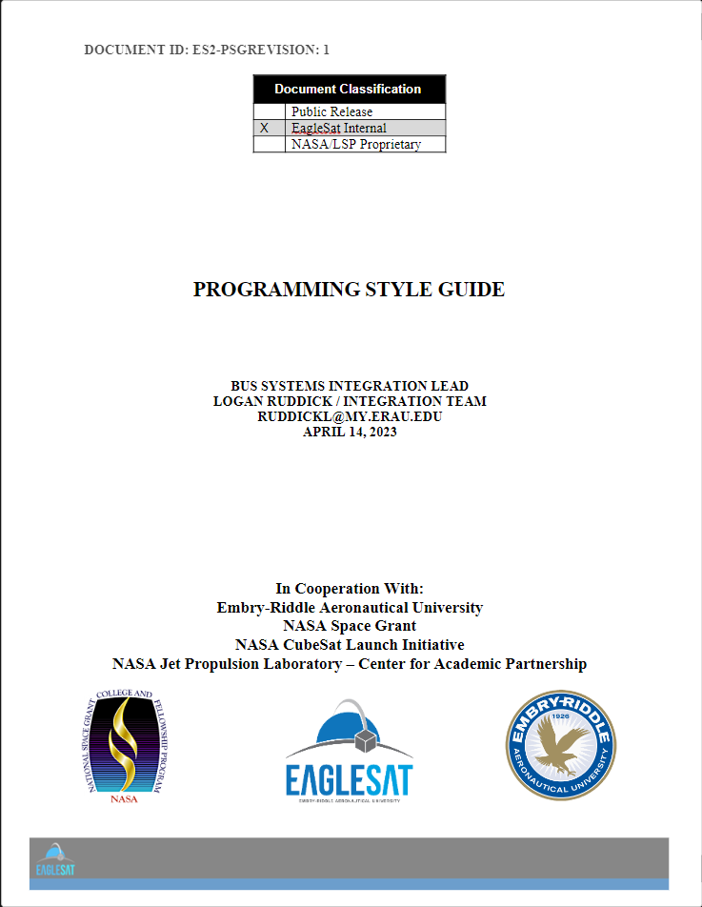
Communications Management - Engineering
Configuration management (Documentation and OOD)
Technical drawings and Code
Documentation Standards and Templates
EagleSat Programming Style Guide with Standard Cover Page

Slide 15
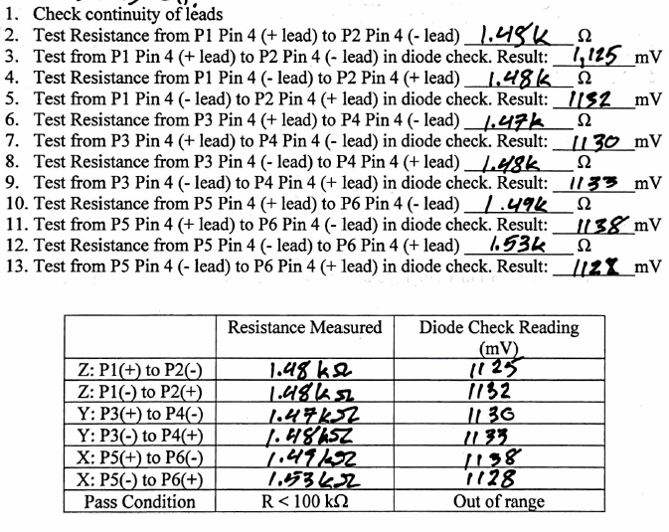
Quality Management
Vital for Aerospace projects
Extensive test Development
Quality ensures requirements are met, mitigates rework
Example Completed Test Procedure

Slide 16
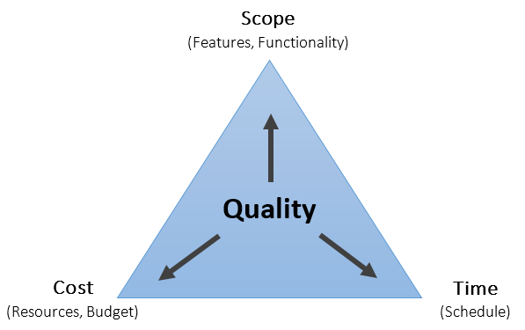
Quality Management
Vital for Aerospace projects
Extensive test Development
Quality ensures requirements are met, mitigates rework
Quality management balancing triangle, medium.com

Slide 17
EagleSat Outcomes
Notes:
Outcomes form EagleSat: After implementing these practices in the EagleSat-2 organization, team was able to efficiently meet deadlines as opposed to the previous performance without such practices acting as a support and guide for our engineers to accomplish their jobs
Before: slipped 6 months in 5 month period, After, Pulled 11 days before originally projected Vibe test delivery

Slide 18
Summary
Project management practices are a powerful tool
  Control the flow of your project
  Handling Communications and Expectations with Stakeholders
Increasingly important as the scale of the project increases
Meet Deadlines and Reduce Cost
Notes:
Summary : Implementing project management practices and methodologies is a powerful tool for controlling the flow of your project and handling communications and expectations with your stakeholders. This is increasingly important ant as the scale of you project becomes complex and expensive as aerospace-oriented projects naturally are.

